Slide 3
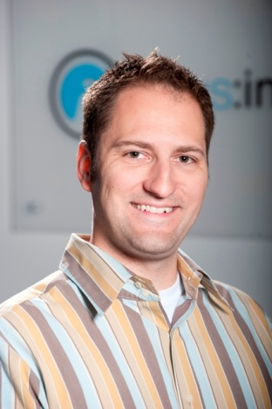
Meet the presenter
Eric Hulbert
Opus Interactive CEO & Co-Founder
Eric earned his degree in Computer Science Engineering from Oregon State University. He is a 2010 recipient of the Council of Outstanding Early Career Engineers Award from OSU and is a current member of the Portland chapter of Entrepreneurs’ Organization (EO).
Eric holds the following industry certifications:
VMware VSP 5 / VSP 5 - Cloud
VMware VTSP 5 / VTSP 5 - Cloud
VMware vCA
ITIL Foundations Certified
MCSE + Security
MCSE + Messaging
MCTS: Hosting
MCTS: Virtualization

Slide 4
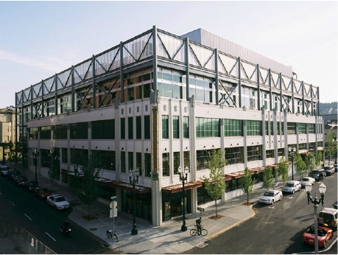
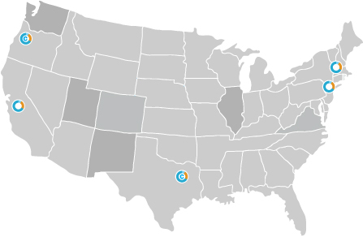
About Opus Interactive
Opus Interactive is a Portland-based company providing services from Tier III+ data centers in Portland, Santa Clara, Dallas, Wall Township NJ, and New York. Founded in 1994, the PCI compliant and SAS70-certified company specializes in consistent delivery of customized business-critical cloud and colocation services to companies that depend on online/networked operations.
A member of the International Managed Services Provider Alliance, Opus Interactive has earned a reputation for superior service and a willingness to go beyond “out-of-the-box” solutions to build customized networks based on the individual equipment, scalability, budget and future growth needs of its clients.
Opus Interactive
Portland Data Center

Slide 5
Webinar agenda
Benefits of cloud computing
Getting from Point A to Point B
Finding the right data center and provider
Questions & Answers
iPad Mini Giveaways!

Slide 6
But first, a quick poll.
Cloud computing is the future model of IT.
Strongly Agree
Agree
Undecided
Disagree
Strongly disagree

Slide 7
88% of IT leaders rate cloud computing as a priority over the next 18 months
60% of enterprises are currently adopting
26% of budgets have been allocated

Slide 8
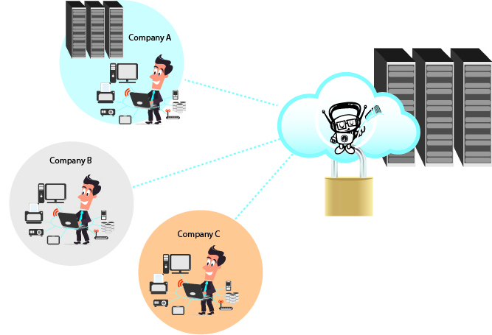
Cloud definitions
Public Cloud An economical solution based on shared resources, allowing you to access your data and applications without shouldering the costs of hardware and software.

Slide 9
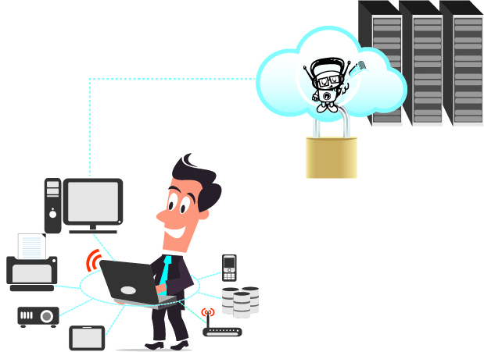
Cloud definitions
Private Cloud A proprietary infrastructure dedicated solely to your use, where you benefit from full scalability and efficiency while maintaining complete control.

Slide 10
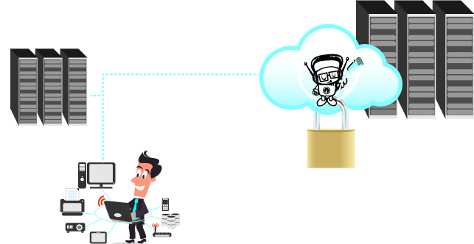
Cloud definitions
Hybrid Cloud A mix-and-match approach that creates an ideal infrastructure of public and private network layers to achieve business agility, budget and data security.

Slide 11
Types of cloud usage
Software-as-a-Service (SaaS) Delivers at the software layer. Gmail is an example of SaaS.
Platform-as-a-Service (PaaS) Delivers IT services on the platform layer, such as an operating system or an application framework.
Infrastructure-as-a-Service (IaaS) Delivers technical infrastructure components such as storage, memory, CPU and network.

Slide 12
Benefits of cloud computing

Slide 13
Benefits
Efficiency through utilization and automation
Delayed IT/datacenter expansion
Lower total cost of ownership (TCO)
Agility with control
Self-service access simplifies IT services
Faster response times
Freedom of choice
Existing OS and application
You decide how much to virtualize
Who wants an iPad Mini? (Survey 1 is being emailed to you right now.)

Slide 14
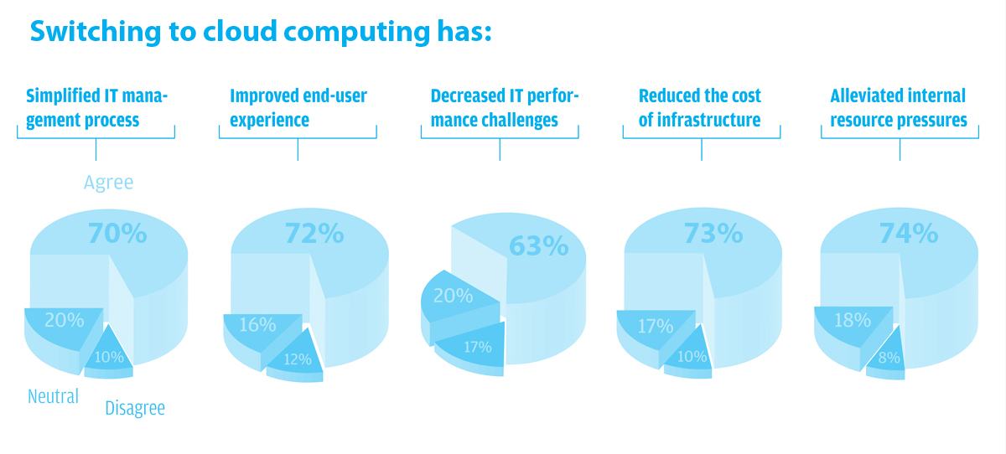
Image courtesy of Cloud Hypermarket www.cloudhypermarket.com

Slide 15
More Benefits
Financial Energy
Capital costs reduced by 50-60%
Delayed datacenter expansion
Operational costs reduced by 25%
Human Energy
Average of 33% reduction in routine admin time (example: provision a server in minutes)
Earth’s Energy
Up to 80% reduction in energy costs

Slide 16
Getting from Point A to Point B (in-house to the cloud)

Slide 17
Case Study: Travel Industry
The conditions
30 years in business
Outgrown solution
Sustainable practices
Their needs
Secure Building
Managed Services
Critical power
Technical support
Colocated systems
The solution
16 Enterprise HP blade servers
3 dedicated SAN nodes
4 virtual load balancers
4 virtual firewalls
Managed Services
Bandwidth
Managed Backup
Critical 24x7 operations
Secure location
Dedicated environment

Slide 18
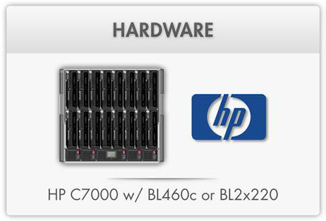
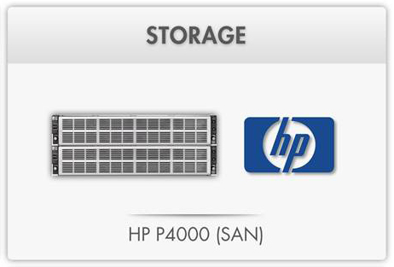
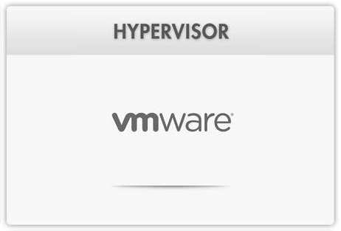
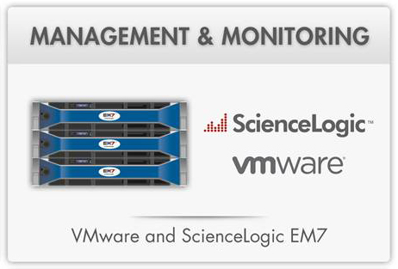

Slide 19
Monitoring

Slide 20
Case Study: Travel industry
The benefits
Hybrid Cloud
Modular
Flexible
Adaptive
Cost-effective

Slide 21
Finding the RIGHT Data Center and Provider
Who wants an iPad Mini? (Survey 2 is being emailed to you right now.)

Slide 22
Assessing your cloud readiness
Analyze your portfolio
Optimize your architecture, infrastructure and procedures
Consider change management in IT
Consider current/future services you need

Slide 23
Assessing your cloud readiness
Outline security protocols and compliance requirements
Determine your budget
Find the right provider for YOU
Outline a migration plan

Slide 24
Assessing your cloud readiness
Existing Equipment
Space
Planning for the future
Equipment Investment
Great news! VMware has an online assessment tool.
http://getcloudready.vmware.com/

Slide 25
Finding the RIGHT fit for YOU
You
Cloud Provider
Willingness to Customize
Company Profile
Support Services
Datacenter
Location
Cloud Readiness
Compliance
Structure

Slide 26
Finding the RIGHT fit for YOU
Environmental Threats
Flooding
Earthquakes
Hurricanes, etc.
Environmental Systems
Cooling
Fire detection & suppression
Physical security
Power Systems
Core power
Critical power
Uninterruptible conditioned power
Backup systems
Water

Slide 27
Finding the RIGHT fit for YOU
Network Carriers
Number of providers
Flexibility to scale
Connectivity
Tier rating
Efficiency
Energy-efficiency (building)
Infrastructure as a whole
Equipment
Entrance Diversity

Slide 28
Questions?

Slide 29
Thank You!

